Slide 1
InsightBot – Document-based Question Answering System

Slide 2
Agent-Based Architecture with MCP Integration
User → Streamlit UI → Ingestion Agent → Retrieval Agent → LLM Response Agent through streamlit
• MCPMessage: Structured message passing between n agents

Slide 3
1. User uploads documents → Streamlit UI → Ingestion Agent → Cleans & stores docs 2. User enters query → Retrieval Agent → Vector search (FAISS) → Relevant docs 3. LLM Response Agent → Builds prompt → Generates concise answer → Displays in UI Example MCPMessage: { sender: 'LLMResponseAgent', receiver: 'User', payload: 'Apple’s skin provides essential fiber.' }
System workflow diagram

Slide 4
Techstack used
• Frontend: Streamlit
• Document Loading: langchain-community
• Text Splitting: RecursiveCharacterTextSplitter
• Vector Store: FAISS
• Embeddings: all-MiniLM-L6-v2 (Sentence Transformers)
• LLM Model: EleutherAI GPT-Neo 125M
• Transformers Pipeline: Hugging Face Transformers
• Data Handling: Python (Tempfile, Re, Dataclasses)

Slide 5
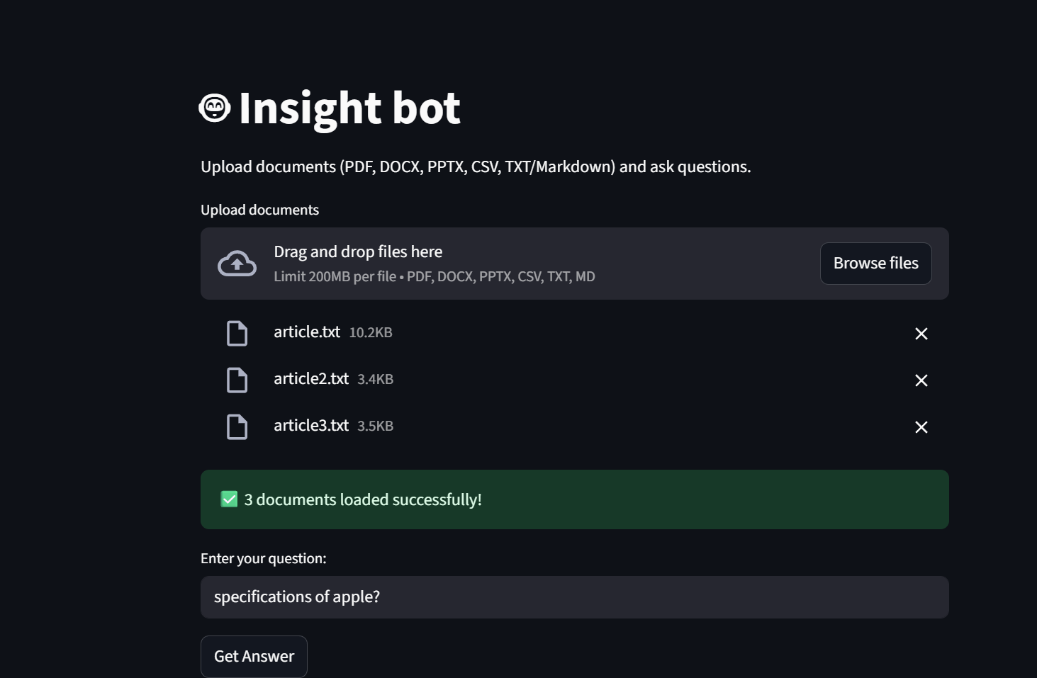
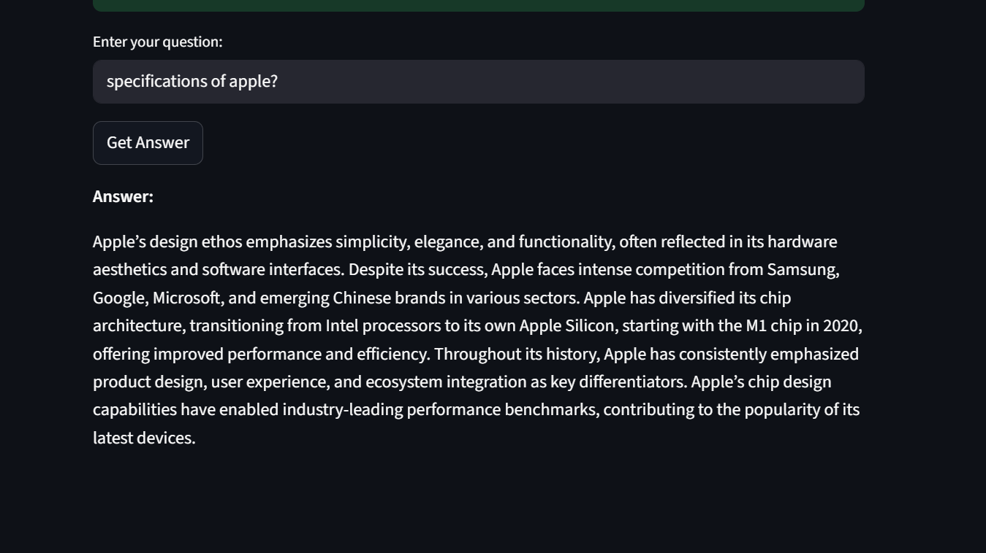
UI images of app
Uploading the files and
asking question
After uploading it gives us the answer to question

Slide 6
Challenges Faced
• Removing repetitive answers from LLM output
• Designing structured MCP message passing
• Ensuring CPU-friendly LLM pipeline
• Handling multiple document types
• Balancing context size for prompt

Slide 7
FUTURE SCOPE
• Web-based document viewer
• PDF export of generated answers
• Advanced filtering (by doc, date, type)
• Multilingual document support
• Use more powerful LLM models with GPU support

